Slide 1

어서와 Java는 처음이지!
제13장 실전프로젝트

Slide 2
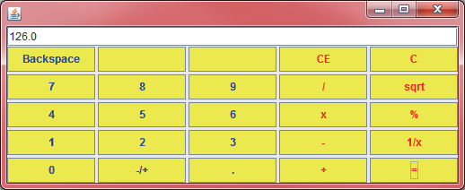
LAB: 계산기 작성
9장의 계산기에 이벤트 처리를 붙여서 완전한 계산기가 되도록 하여 보자.

Slide 3
SOLUTION
public class Calculator extends JFrame implements ActionListener {
private JPanel panel;
private JTextField display;
private JButton[] buttons;
private String[] labels = { "Backspace", "", "", "CE", "C", "7", "8", "9",
"/", "sqrt", "4", "5", "6", "x", "%", "1", "2", "3", "-", "1/x",
"0", "-/+", ".", "+", "=", };
private double result = 0;
private String operator = "=";
private boolean startOfNumber = true;
public Calculator() {
display = new JTextField(35);
panel = new JPanel();
display.setText("0.0");
//display.setEnabled(true);

Slide 4
SOLUTION
panel.setLayout(new GridLayout(0, 5, 3, 3));
buttons = new JButton[25];
int index = 0;
for (int rows = 0; rows < 5; rows++) {
for (int cols = 0; cols < 5; cols++) {
buttons[index] = new JButton(labels[index]);
if (cols >= 3)
buttons[index].setForeground(Color.red);
else
buttons[index].setForeground(Color.blue);
buttons[index].setBackground(Color.yellow);
panel.add(buttons[index]);
buttons[index].addActionListener(this);
index++;
}
}
add(display, BorderLayout.NORTH);
add(panel, BorderLayout.CENTER);
setVisible(true);
pack();
}

Slide 5
SOLUTION
public void actionPerformed(ActionEvent e) {
String command = e.getActionCommand();
if (command.charAt(0) == 'C') {
startOfNumber = true;
result = 0;
operator = "=";
display.setText("0.0");
} else if (command.charAt(0) >= '0' && command.charAt(0) <= '9'
|| command.equals(".")) {
if (startOfNumber == true)
display.setText(command);
else
display.setText(display.getText() + command);
startOfNumber = false;
} else {
if (startOfNumber) {
if (command.equals("-")) {
display.setText(command);
startOfNumber = false;
} else
operator = command;
} else {
double x = Double.parseDouble(display.getText());
calculate(x);
operator = command;
startOfNumber = true;
}
}
}

Slide 6
SOLUTION
private void calculate(double n) {
if (operator.equals("+"))
result += n;
else if (operator.equals("-"))
result -= n;
else if (operator.equals("*"))
result *= n;
else if (operator.equals("/"))
result /= n;
else if (operator.equals("="))
result = n;
display.setText("" + result);
}
public static void main(String args[]) {
Calculator s = new Calculator();
}
}

Slide 7
Q & A

